Slide 1
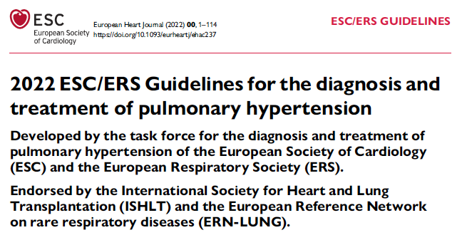
Released Aug 26, 2022
Brian Locke, MD
Notes:
Last 2015
Galie N, Humbert M, Vachiery JL, et al. 2015 ESC/ERS Guidelines for the diagnosis andtreatment of pulmonary hypertension: The Joint Task Force for the Diagnosis and Treatment of Pulmonary Hypertension of the European Society of Cardiology (ESC) and the European Respiratory Society (ERS): Endorsed by: Association for European Paediatric and Congenital Cardiology (AEPC), International Society for Heart and Lung Transplantation (ISHLT). Eur Heart J 2016;37(1):67-119. This consensus document is still included as it contains recommendations on diagnostic evaluation. PMID: 26320113 Free Full Text
Update from 2019 World Lung Symposium
Simonneau G, Montani D, Celermajer DS, et al. Haemodynamic definitions and updated clinical classification of pulmonary hypertension. Eur Repir J. 2019;53(1). The 6th World Symposium on Pulmonary Hypertension proposes a new threshold of mPAP of 20mmHg as the upper limit of normal value. PMID: 30545968 Free Full Text
Comparison CHEST 2019
Klinger JR, Elliott CG, Levine DJ, et al. Therapy for pulmonary arterial hypertension in adults: update of the CHEST guideline and expert panel report. Chest. 2019;155:565-586. This is a timely update to the 2014 guideline that summarizes the indications for each of the many therapeutic classes based on severity of symptoms, vasoreactivity, and prior treatment. There is a new emphasis on earlier use of combination therapy. PMID: 30660783

Slide 2
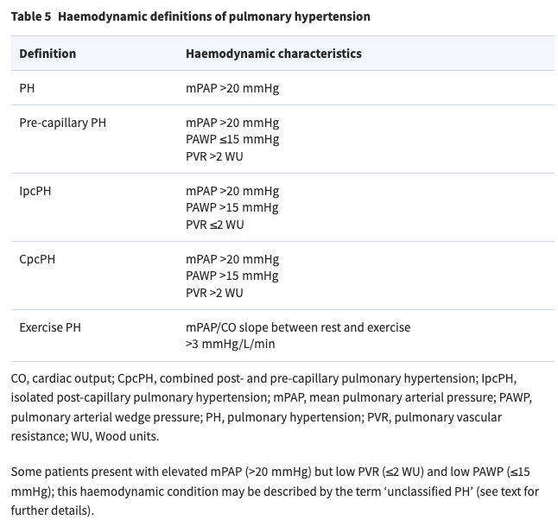
2019: 6th World Symposium update to mPAP 20mHg
Treatment for mPAP 20-25, WU 2-3?
Exercise PH:
Normal range for mPAP/CO slope: 1.6 – 3.3 mmHg/L/min supine, age dependent (?60+)
Unclassified PH

Slide 3
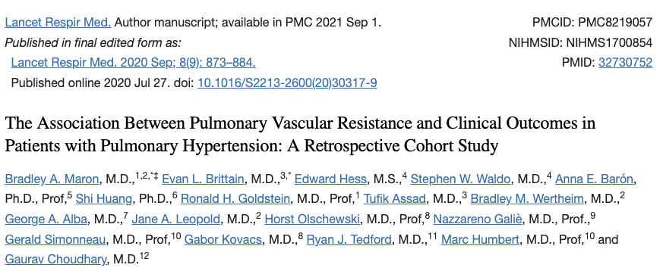
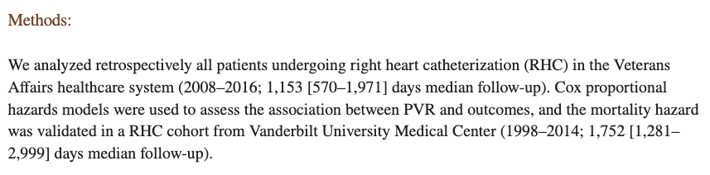
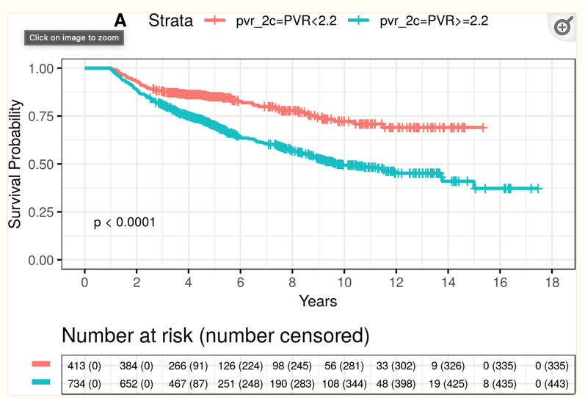
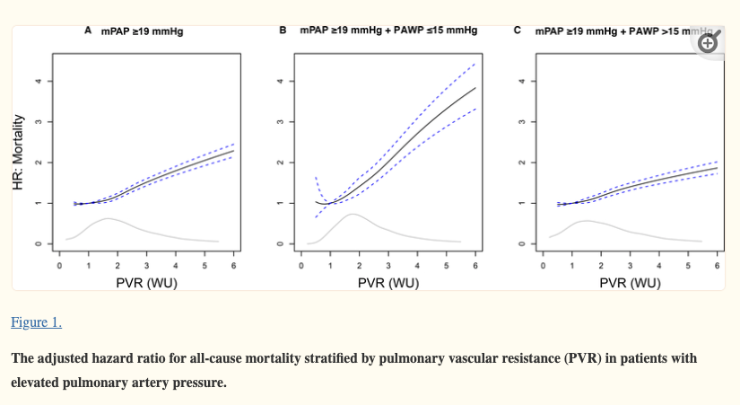

Slide 4
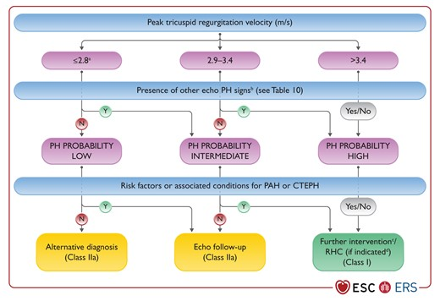
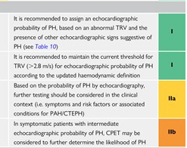
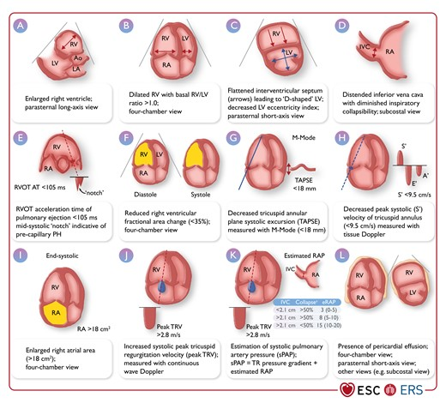
Diagnosis
Notes:
Concerning the diagnosis of PH, a new algorithm has been developed aiming at earlier detection of PH in the community. In addition, expedited referral is recommended for high-risk or complex patients. Screening strategies are also proposed.
Compare: CHEST has recommendation for systematic assessment but not specified.
RVSP: 4* 2.8^2 + RA_p = 31.36 + RA_p
RVSP: 4* 3.4^2 + RA_p = 46.24 + RA_P

Slide 5
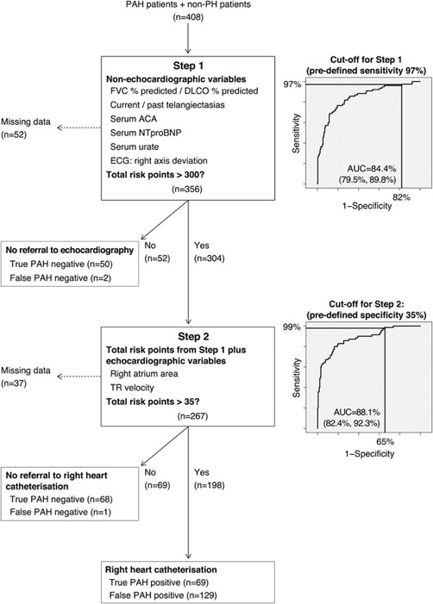
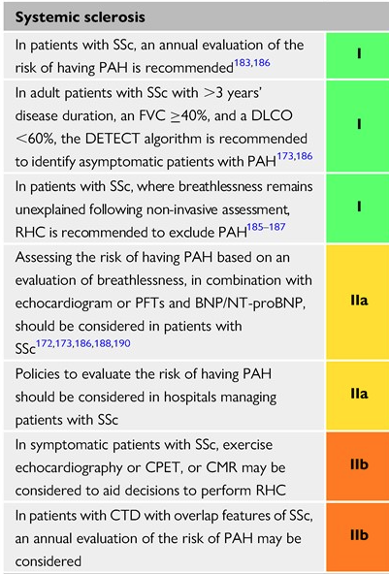
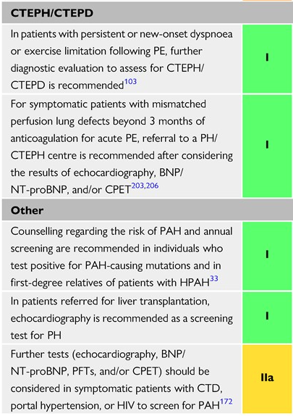

Screening: SSc, PoPH prior to transplant. Not in PE
Notes:
Pulmonary arterial hypertension is a well-known pulmonary vascular complication of SSc,^{173,502–504} systemic lupus erythematosus (SLE),^{505–507} mixed CTD,⁵⁰⁶ and, rarely, dermatomyositis⁵⁰⁸ and Sjögren’s syndrome.⁵⁰⁹ Conversely, the relationship between rheumatoid arthritis and PAH is not established.⁵¹⁰
PAH – CTD follows IPAH algorithm
HIV – start with monotherapy
PoPH – if unclassified (>20 mpap, elevated CO, PVR<2) no treatment; high mortality of mPAP over 35 (50+%)
Annual screening
In the case of patients with SSc, the progression from “borderline” to “classic” PH has been reported in approximately 40% of patients with SSc within 4 years

Slide 6
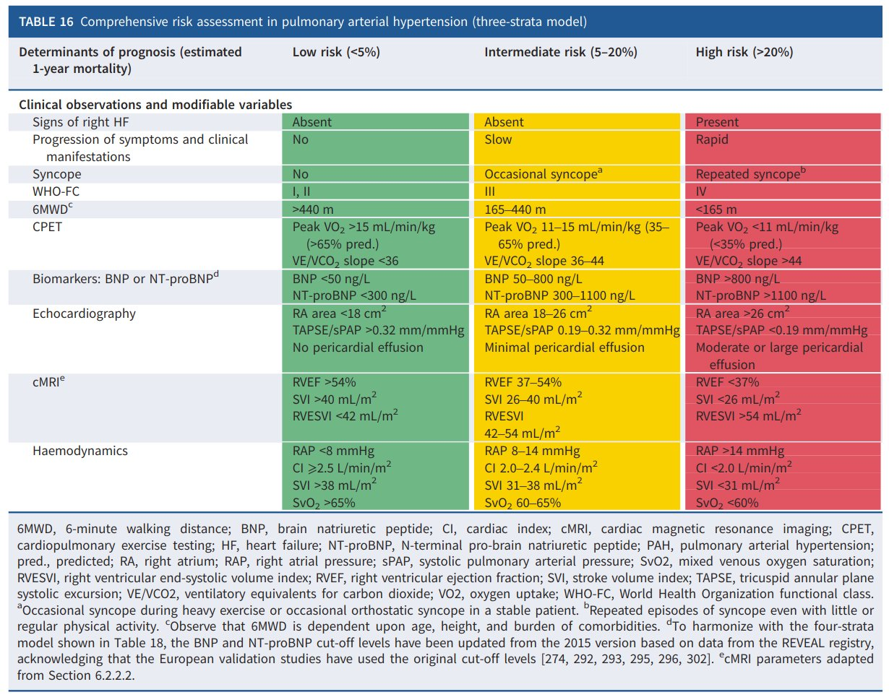
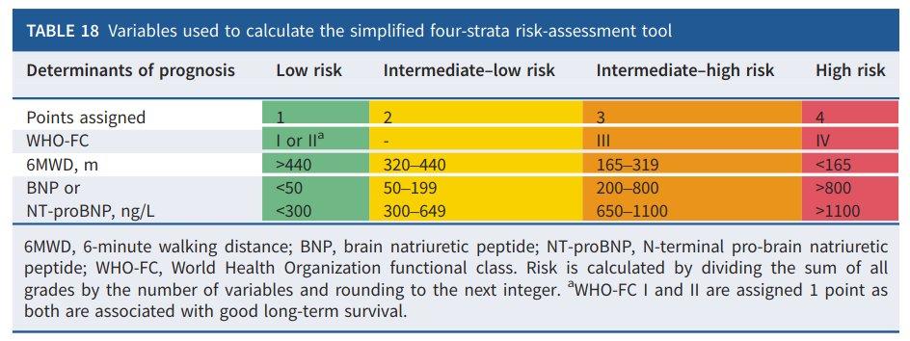
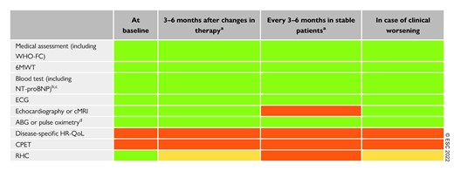
Risk stratification and Monitoring
Notes:
The recommendations for initial drug therapies have been simplified, building on this revised, three-strata, multiparametric risk model to replace functional classification.
A four-strata risk stratification, dividing the large, intermediate-risk group into intermediate–low and intermediate–high risk, is proposed at follow-up.
Less emphasis on symptoms and more emphasis on risk, I think, than the CHEST guideline.

Slide 7
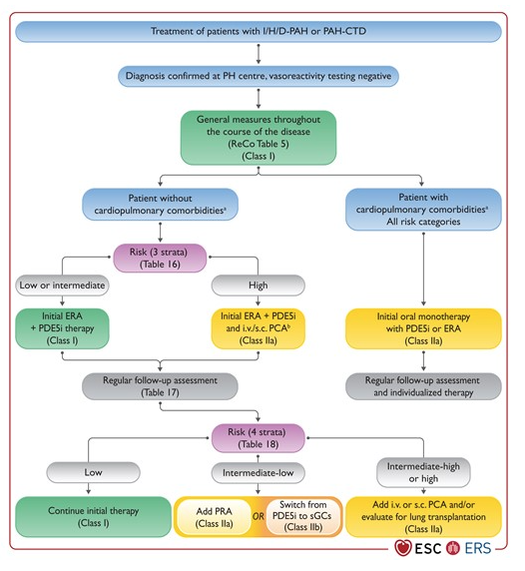
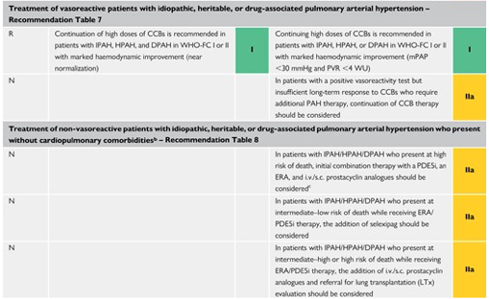
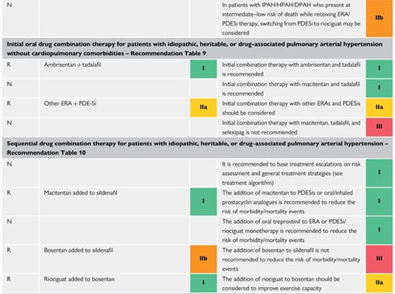
Notes:
Treatment of PAH (IPAH, HPAH, DPAH, PAH-CTD)
No complications:
ERA & PDE5 inhibs if lower risk; consider adding triple therapy IV or SC prostacyclin if high risk at initial assessment or if they are anything other than low risk at follow-up
Monotherapy initially if cardiopulmonary comorbidities.
In comparison to CHEST algorithm – I think this leads to more combination therapy and triple therapy

Slide 8
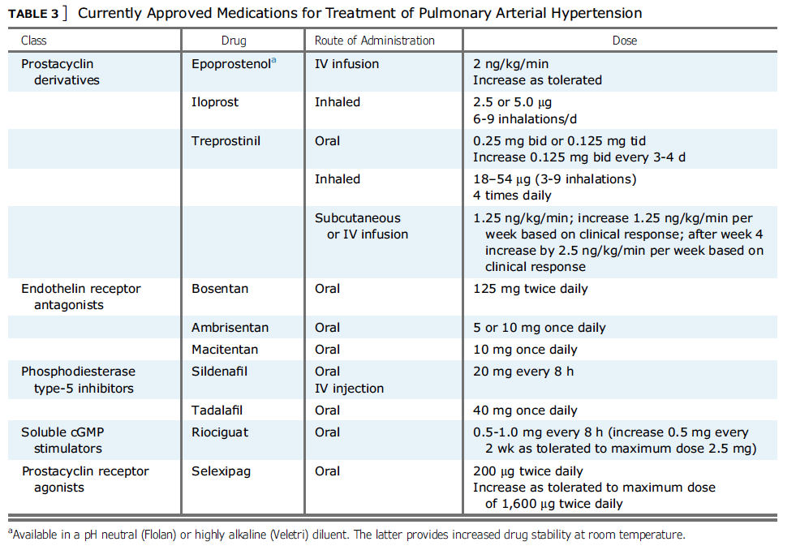
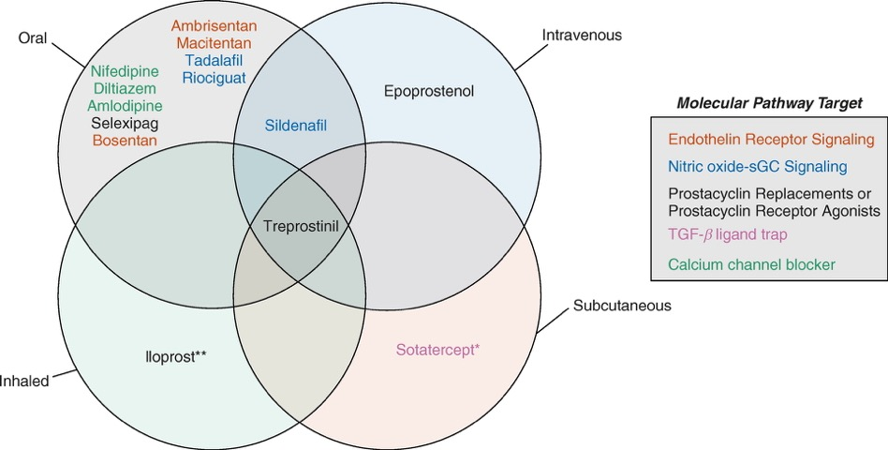
PAH medications
Notes:
https://www.atsjournals.org/doi/full/10.1164/rccm.202012-4317SO

Slide 9
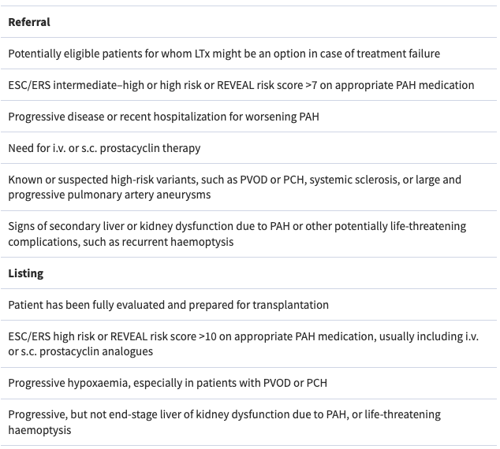
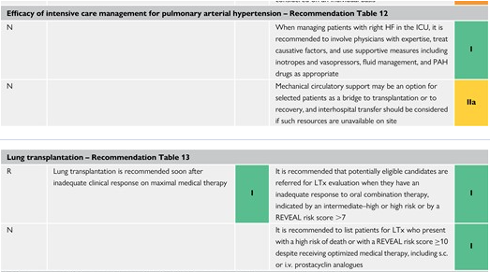
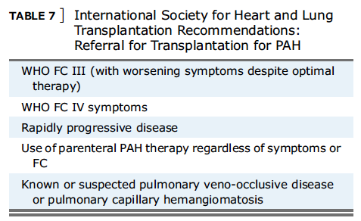
ICU Management, Transplan t

Slide 10
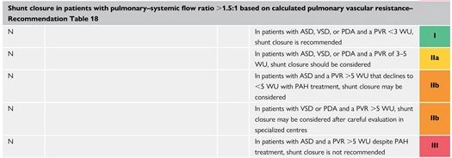
Congenital Heart disease
Notes:
The recommendations for managing PH associated with left heart disease (PH-LHD) and lung disease have been updated, including a new haemodynamic definition of severe PH in patients with lung disease.

Slide 11
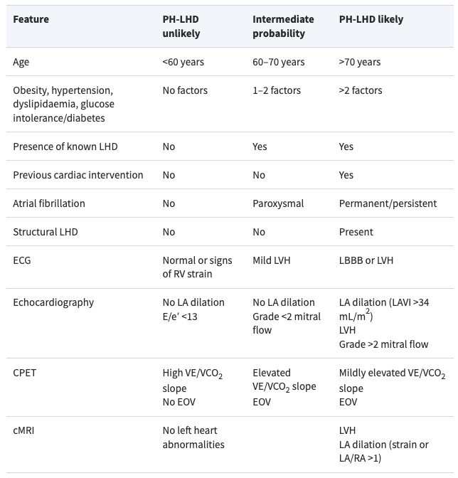
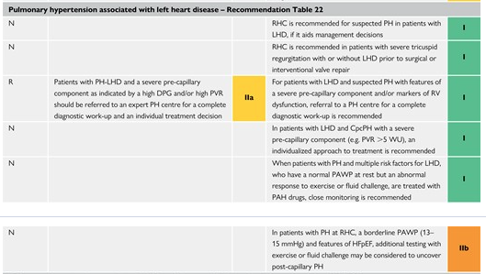
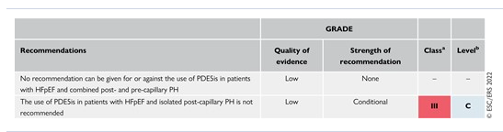
Group 2= IpcPH: PVR<2WU, CpcPH: PVR>2WU
Notes:
Woods units, not diastolic pressure gradient
ULN PAWP: 12 mmHg, but threshold for CHF is 15mmHg (same as prior)
Cardiomems? Discussed some here: PubMed: 33861689

Slide 12
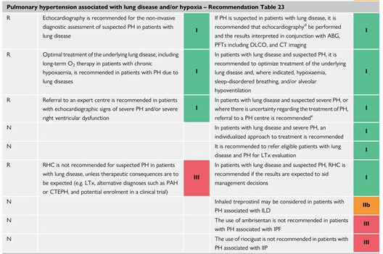
Group 3: Severe (PVR >5 WU), non-severe PH (PVR ≤5 WU)
TTE less accurate
TRV unmeasurable >50%
Overestimates PAP
Severe PH indep of Spiro
Stronger assoc PaO2, DLCO, low CO2
?OHS
Notes:
Pulmonary hypertension is uncommon in obstructive sleep apnoea unless other conditions coexist, such as COPD or daytime hypoventilation.⁷⁰⁹ At high altitude (>2500 m) hypoxia-induced PH is thought to affect >5% of the population, the development of PH being related to geography and genetic factors
the accuracy of echocardiography in patients with advanced respiratory diseases is low, with a TRV unmeasurable in >50% of patients in some studies, and there is a tendency to overestimate PAP and misclassify patients with PH
severe PH is largely independent of spirometry but usually accompanied by hypoxaemia, low PaCO₂, and a significant reduction in DLCO
Frequency of severe PH in OHS is not known (5WU)
For the first time, there is a recommendation for PH medical therapy in group 3 PH, based on a single positive RCT in patients with ILD. – inhaled Treprostinil
“Gap: The impact of the hypobaric and hypoxic environment of the >150 million people living at >2500 m altitude has to be clarified, and studies need to be performed to assess potential treatment strategies for PH.“
“Arcasoy SM, Christie JD, Ferrari VA, et al. Echocardiographic assessment of pulmonary hypertension in patients with advanced lung disease. Am J Respir Crit Care Med 2003; 167:735-40. The cardiology literature indicates echocardiography-derived estimates of pulmonary artery pressures are accurate. This study found 52% of echo estimates were inaccurate (off by > 10 mmHg) in 166 lung transplant candidates and the difference was > 20 mmHg in 28%. In patients without hypertension, echo was more likely to overestimate pressures while in patients with pulmonary hypertension; it was as likely to over as underestimate. Accuracy and ability to obtain an estimate varied with the underlying disease. PMID: 12480614”

Slide 13
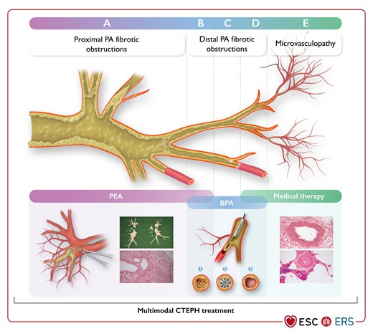
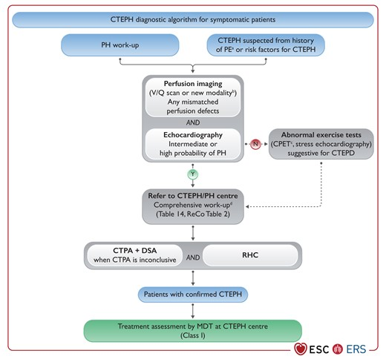
CTEPD (+/- PH)
Notes:
In group 4 PH, the term chronic thrombo-embolic pulmonary disease (CTEPD) with or without PH has been introduced, acknowledging the presence of similar symptoms, perfusion defects, and organized fibrotic obstructions in patients with or without PH at rest. Interventional treatment by balloon pulmonary angioplasty (BPA) in combination with medical therapy has been upgraded in the therapeutic algorithm of CTEPH.
CTEPD describes symptomatic patients with mismatched perfusion defects on V/Q scan and with signs of chronic, organized, fibrotic clots on computed tomography pulmonary angiography or digital subtraction angiography, such as ring-like stenoses, webs/slits, and chronic total occlusions (pouch lesions or tapered lesions), after at least 3 months of therapeutic anticoagulation.
Clinical conditions such as permanent intravascular devices (pacemaker, long-term central lines, ventriculoatrial shunts), inflammatory bowel diseases, essential thrombocythaemia, polycythaemia vera, splenectomy, antiphospholipid syndrome, high-dose thyroid hormone replacement, and malignancy are risk factors for CTEPH
The treatment algorithm for CTEPH has been modified, including multimodal therapy with surgery, PH drugs, and BPA.
Regardless of the result of PEA/BPA, patients should be regularly followed-up, including invasive assessment with RHC 3–6 months after intervention, allowing for consideration of a multimodal treatment approach.
To optimize patients’ outcomes, CTEPH centres should fulfil criteria for a PH centre (Section 12) and have a CTEPH multidisciplinary team consisting of a PEA surgeon, BPA interventionist, PH specialist, and thoracic radiologist, trained in high-volume PEA and/or BPA centres. The team should meet regularly to review new referrals and post-treatment follow-up cases. Ideally, CTEPH centres should have PEA activities (>50/year)⁸¹⁰ and BPAs (>30 patients/year or >100 procedures/year),⁷⁸¹ as these figures have been associated with better outcome
“An improved recognition of computed tomography (CT) and echocardiographic signs of chronic thromboembolic pulmonary hypertension (CTEPH) at the time of an acute pulmonary embolism (PE) event, together with a systematic follow-up of patients with acute PE, should help to remediate the underdiagnosis of CTEPH.“

Slide 14
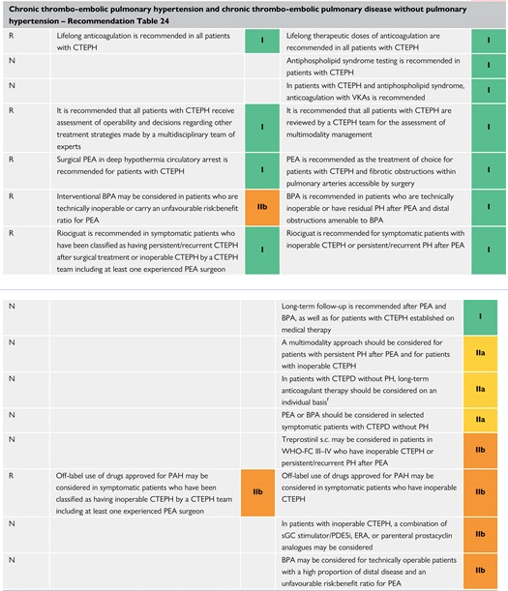
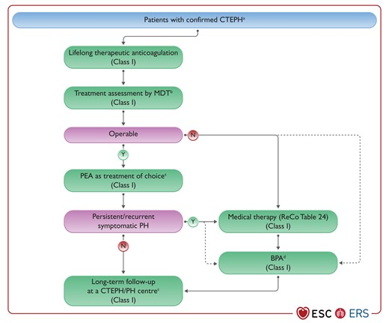
CTEPD (+/- PH)
Notes:
In group 4 PH, the term chronic thrombo-embolic pulmonary disease (CTEPD) with or without PH has been introduced, acknowledging the presence of similar symptoms, perfusion defects, and organized fibrotic obstructions in patients with or without PH at rest. Interventional treatment by balloon pulmonary angioplasty (BPA) in combination with medical therapy has been upgraded in the therapeutic algorithm of CTEPH.
CTEPD describes symptomatic patients with mismatched perfusion defects on V/Q scan and with signs of chronic, organized, fibrotic clots on computed tomography pulmonary angiography or digital subtraction angiography, such as ring-like stenoses, webs/slits, and chronic total occlusions (pouch lesions or tapered lesions), after at least 3 months of therapeutic anticoagulation.
Clinical conditions such as permanent intravascular devices (pacemaker, long-term central lines, ventriculoatrial shunts), inflammatory bowel diseases, essential thrombocythaemia, polycythaemia vera, splenectomy, antiphospholipid syndrome, high-dose thyroid hormone replacement, and malignancy are risk factors for CTEPH
The treatment algorithm for CTEPH has been modified, including multimodal therapy with surgery, PH drugs, and BPA.
Regardless of the result of PEA/BPA, patients should be regularly followed-up, including invasive assessment with RHC 3–6 months after intervention, allowing for consideration of a multimodal treatment approach.
To optimize patients’ outcomes, CTEPH centres should fulfil criteria for a PH centre (Section 12) and have a CTEPH multidisciplinary team consisting of a PEA surgeon, BPA interventionist, PH specialist, and thoracic radiologist, trained in high-volume PEA and/or BPA centres. The team should meet regularly to review new referrals and post-treatment follow-up cases. Ideally, CTEPH centres should have PEA activities (>50/year)⁸¹⁰ and BPAs (>30 patients/year or >100 procedures/year),⁷⁸¹ as these figures have been associated with better outcome
“An improved recognition of computed tomography (CT) and echocardiographic signs of chronic thromboembolic pulmonary hypertension (CTEPH) at the time of an acute pulmonary embolism (PE) event, together with a systematic follow-up of patients with acute PE, should help to remediate the underdiagnosis of CTEPH.“

Slide 15
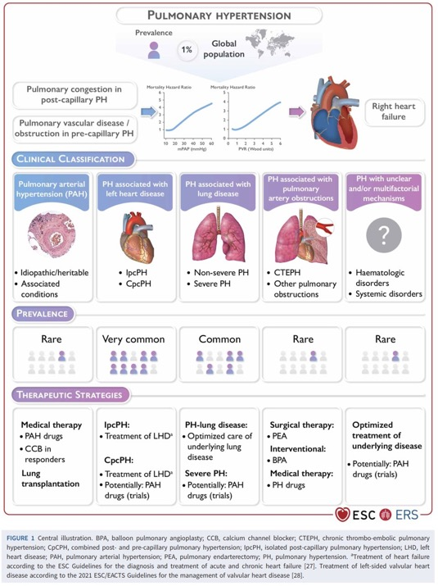
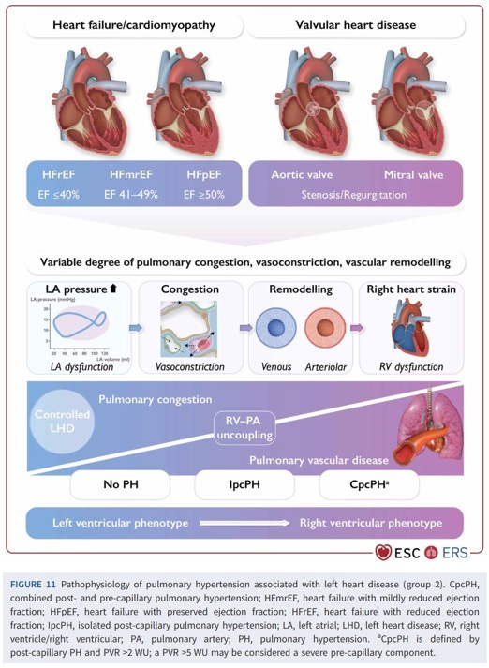
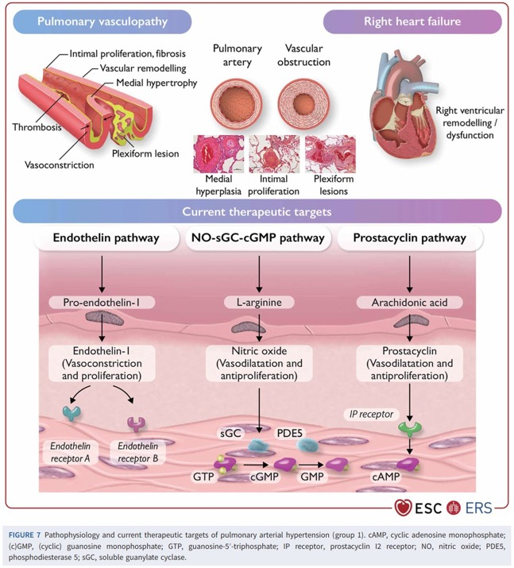
The End
Notes:
Other issues:
Pregnancy related
Designation of PAH centers
The recommendations for rehabilitation and exercise programs in PH have been updated following the release of additional supportive evidence. Patients with PAH should be treated with the best standard of pharmacological treatment and be in a stable clinical condition before embarking on a supervised rehabilitation program.

